Slide 1
gFacet
Milan Branković
University of Belgrade
School of Electrical Engineering
Department of Computer Science

Slide 2
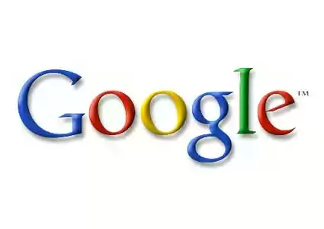
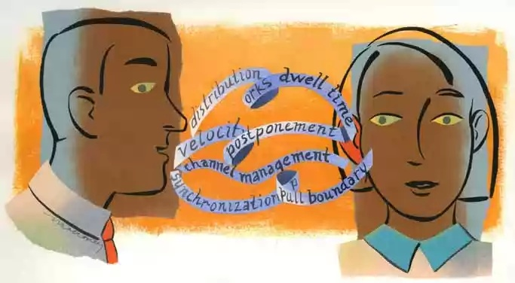
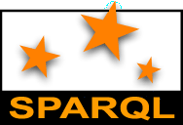
THE PROBLEM
Common Web:
Entering words in an input field (e.g. Google)
High recall, low precision
Problem: Ambiguity
Natural language is ambiguous!
Finding the right information, however, requires the semantic of what should be searched to be specified by the user
Solution:
Artificial query languages like SPARQL that are uniquely defined

Slide 3

THE PROBLEM
Problem: Required knowledge
SPARQL requires the language to be learned by the user (rather a task for experts)
Solution:
Intuitive graphical interfaces to express search queries that are semantically unique but do not require any extra knowledge!
How can they look like?

Slide 4

PROBLEM IMPORTANCE
Human involvement is necessary to interpret and combine results
The meaning of Web content is not machine-accessible: lack of semantics
It is simply difficult to distinguish the meaning between these two sentences:
I am a professor of computer science.
I am a professor of computer science, you may think. Well, I am. . .

Slide 5
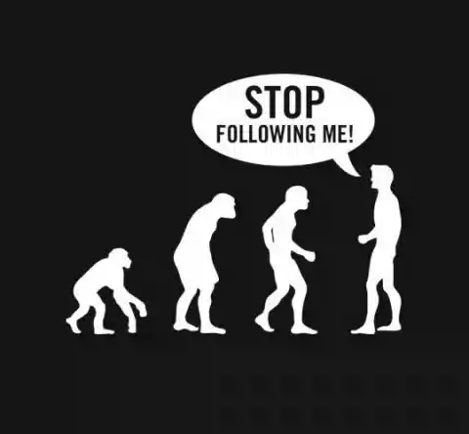
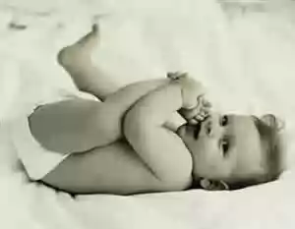
PROBLEM TREND
Appropriate tools for searching the Web are still at infancy level
The Semantic Web will gradually evolve out of the existing Web

Slide 6
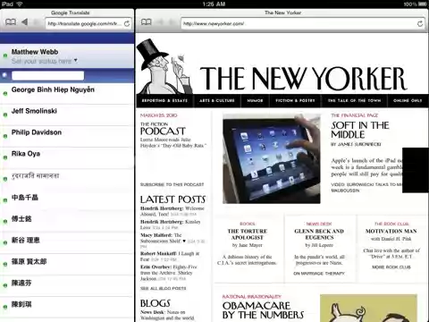
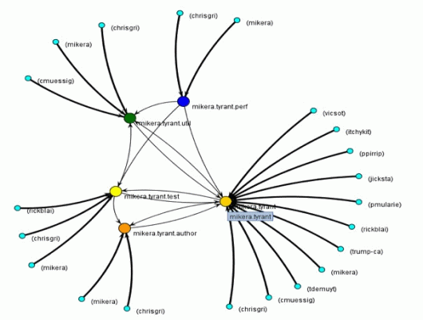
Overview of Existing Approaches
Graph-based approach that explicitly visualizes the structure of the RDF datasets by nodes and edges
The second group divides the screen into several areas, each containing a subset of the data, allowing for faceted browsing

Slide 7
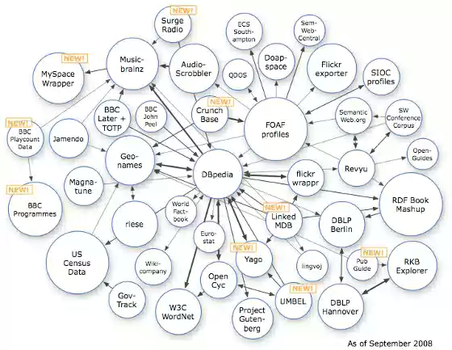
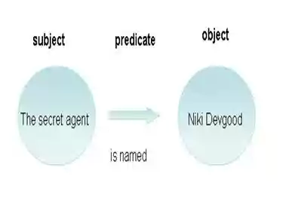
Graph-based Approach
The RDF syntax is based on triples in the form of subject-predicate-object expressions
Using a visualization that directly presents this RDF graph structure to the users seems obvious and is suitable to show the structural complexity of the relations within the data
RDF datasets are often large and highly interconnected, visualizing all the relations that exist within the graph structure can quickly cause a high number of edge crossings and hence hinder an understandable visualization of the data
Not appropriate to visualize complex interrelations within large datasets

Slide 8
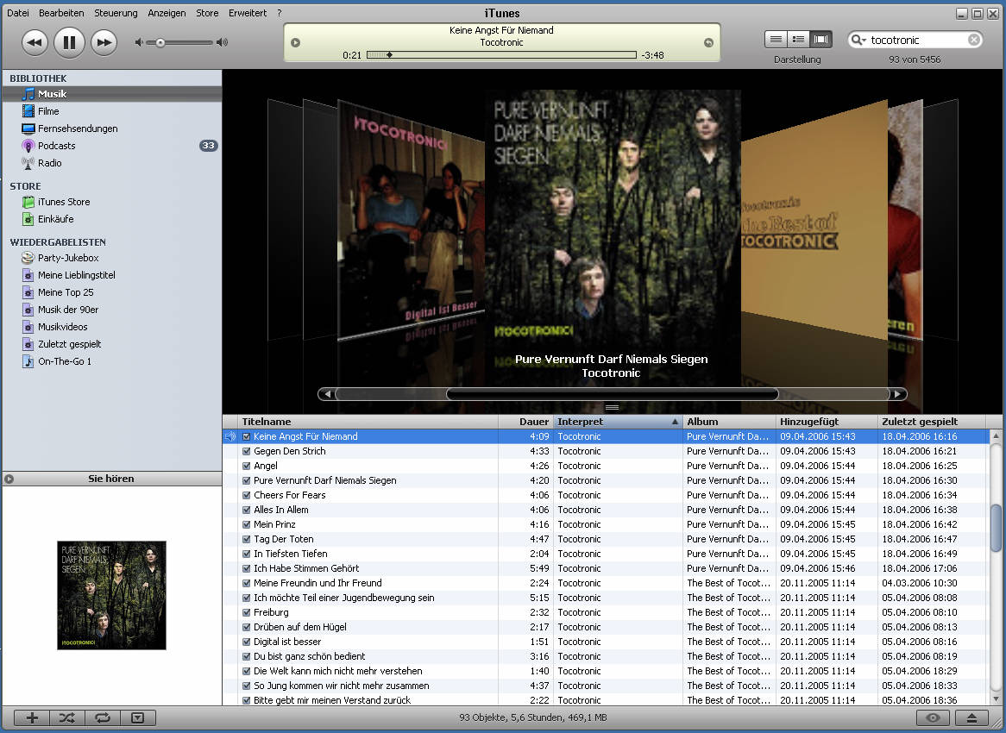
Facet-based Approach
The data gets partitioned using orthogonal conceptual dimensions
iTunes that uses the faceted filtering approach to let the user access music according to different attributes, such as the artist, album, or genre
The faceted-browsing paradigm is especially applicable to large datasets with many interrelations
Limited only to facets that are directly related to the result set

Slide 9
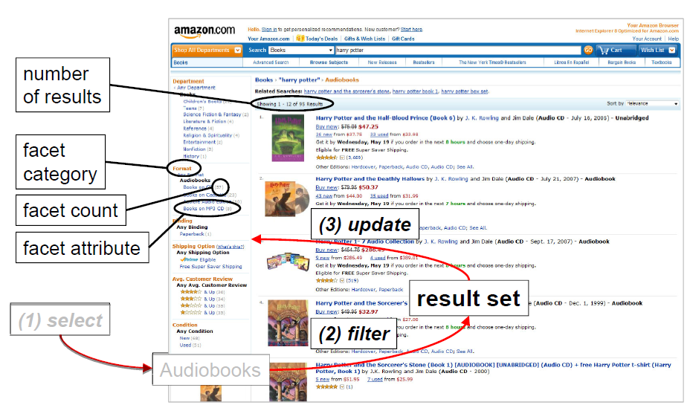
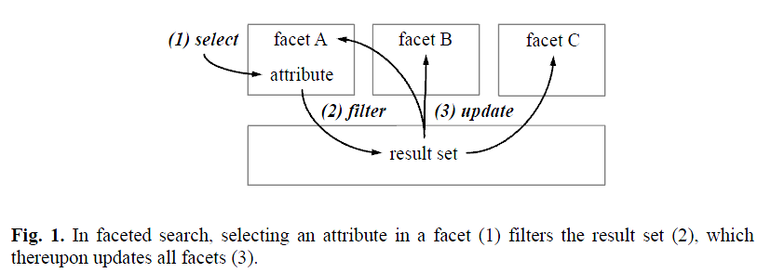
Faceted Search: An Introduction
The search space gets partitioned using orthogonal conceptual dimensions whereas one acts as the result set and the others as facets
The facets can then be used to filter the result set by different attributes that can be selected independently from each other
Notes:
Advantages:
- Facets and their attributes are given (reduced effort)
- Attributes are categoriezed (understanding)
- No facet attribute can lead to an empty result set
- Resulting number of results is shown in advance
- Rapid update of result set (dynamic queries)
- Selected attributes are shown and can be deselected

Slide 10
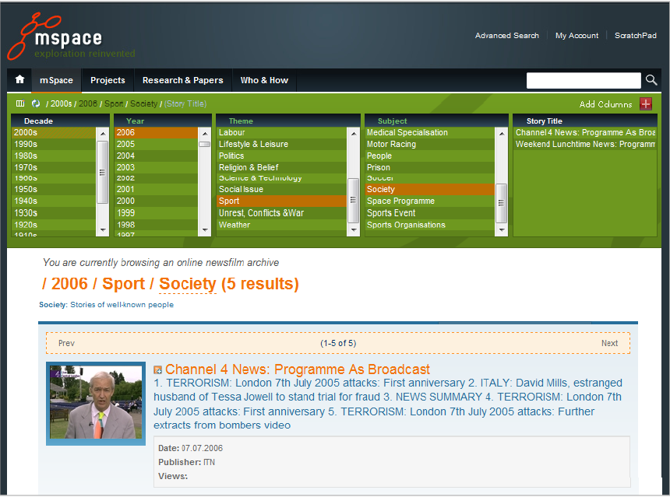
Existing solutions
MSPACE (Hearst 2002)
Disadvantages:
No facet count (number of results to expect)
First order facets only (no hierarchy given)

Slide 11
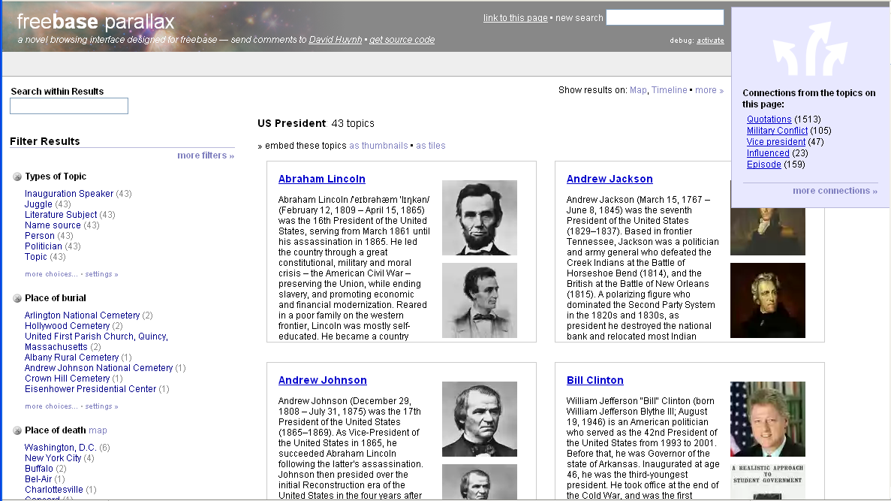
Existing solutions
Parallax (Huynh and Karger 2009)
Advantage:
Hierarchical facets possible (second or higher order facets)
Disadvantages:
Hierarchy not visible
Browsing required

Slide 12
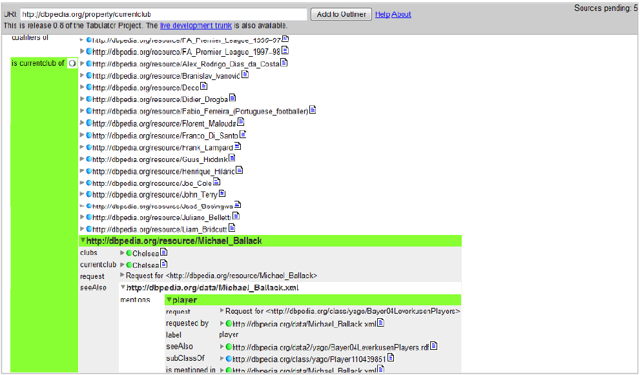
Existing solutions
Tabulator (Berners-Lee 2008)
Advantages:
Hierarchical facets
Hierarchy on one page
Disadvantages:
Attributes get partitioned in different subtrees
Redundant attributes

Slide 13
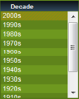
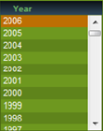
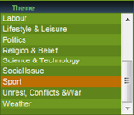

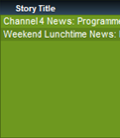
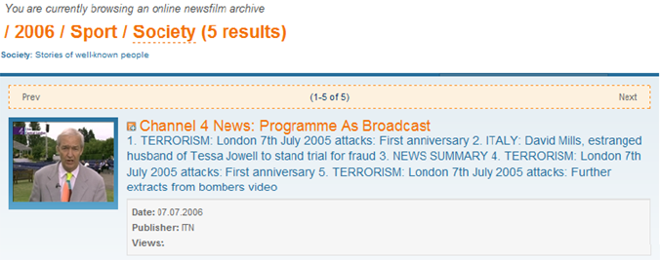
FACET GRAPHS
Idea: Facets and result set are represented as nodes in a graph visualization
facets
categories
(labeled edges)
result set
Notes:
Facets and result set are represented as nodes in a graph visualization and are connected by labeled edges that fosters users’ understanding of the relationships between the facets and also allows for an easy extension by further nodes and edges. The graph provides a coherent representation of multiple, even distantly connected facets on one page

Slide 14
FACET GRAPHS
to combine the graph-based and the facet-based approach by arranging facets as nodes in a graph structure
to visualize and interact with hierarchical facets that aims at preventing large and confusing tree structures and hence facilitates an easy generation of semantically unique queries by the user
Notes:
To avoid the ambiguity of natural language queries, users only select already defined attributes organized in facets to build their search queries. The facets are represented as nodes in a graph visualization and can be interactively added and removed by the users in order to produce individual search interfaces. This provides the possibility to generate interfaces in arbitrary complexities and access arbitrary domains. Even multiple and distantly connected facets can be integrated in the graph facilitating the access of information from different user defined perspectives. Challenges include massive amounts of data, massive semantic relations within the data, highly complex search queries and users’ unfamiliarity with the Semantic Web.

Slide 15
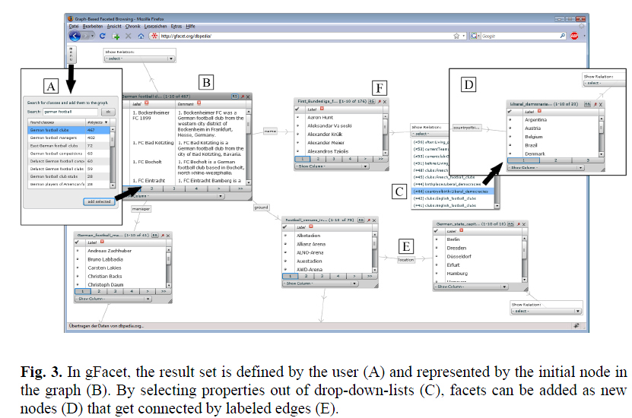
FACET GRAPHS
SPARQL
Query
SELECT DISTINCT ?class ?label COUNT(?o) AS ?numOfObj
WHERE { ?class rdf:type skos:Concept .
?o skos:subject ?class .
?class rdfs:label ?label .
?label bif:contains "german and football" .
FILTER (lang(?label) = "en") }
ORDER BY DESC(?numOfObj) LIMIT 30
SELECT DISTINCT ?prop ?newClass
COUNT(DISTINCT ?objNewClass) AS ?numOfObj
WHERE {
?objCurrClass skos:subject <URIofGermanFootbalClubs> .
?objCurrClass ?prop ?objNewClass .
?objNewClass skos:subject ?newClass .
?newClass rdf:type skos:Concept .}
ORDER BY DESC(?objNewClass) ?prop ?newClass LIMIT 40
several facets with the same property but with different classes,
or different properties but with the same class

Slide 16
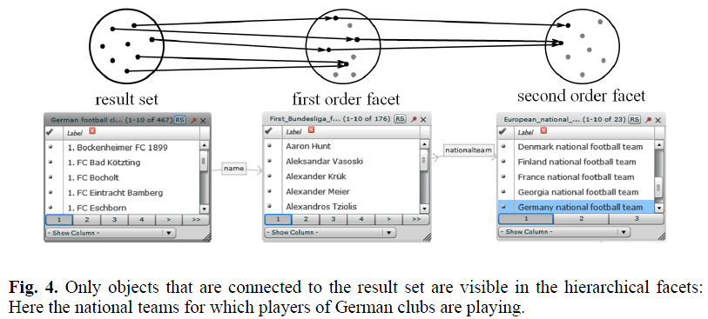
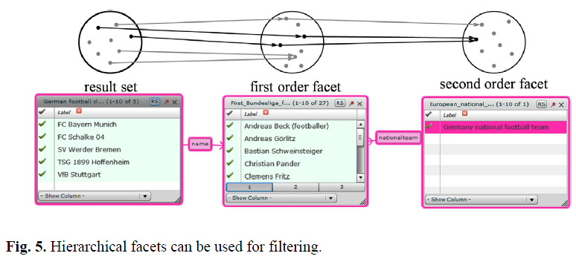
FACET GRAPHS
Hierarchical facets:

Slide 17
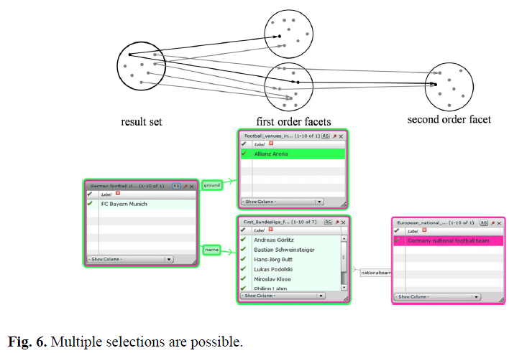
FACET GRAPHS
Multiple selections:

Slide 18
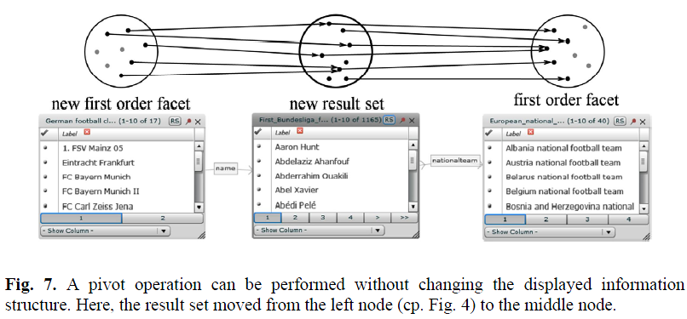
FACET GRAPHS
Pivot operation:
While using gFacet, users may change their minds about what they want to search

Slide 19
FACET GRAPHS
gFacet:
Flash application (animation, independence, no installation)
SPARQL queries (standard, data set independent)
Open source (http://code.google.com/p/gfacet/)
General benefits of Facet Graphs:
Attributes for each facet are grouped into one node
All nodes are shown in a coherent presentation on one page (single coherent visualization)
Semantic relations between the nodes are represented by labeled edges
Facets can be added and removed by the user (individual search interfaces)
Prevention of an over-cluttered graph
Representation of relations between facets

Slide 20
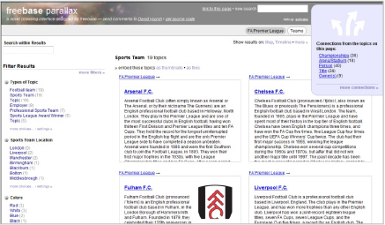
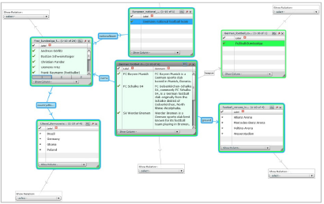
Parallax vs. gFacet
vs.
Three different types of tasks:
Find two players who are playing for a certain club
Find two cities where players who are playing for a certain club are born
Find one player who is playing for a certain club and is born in a certain city
Notes:
Participants in the one group used gFacet first and then Parallax, while
participants in the other group used Parallax first and then gFacet

Slide 21
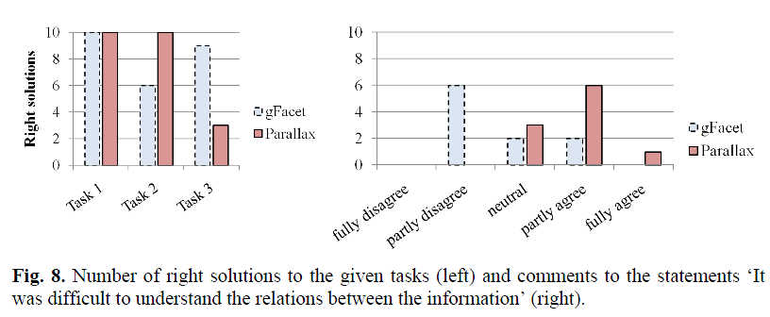
Parallax vs. gFacet
Three different types of tasks:
Find two players who are playing for a certain club.
Find two cities where players who are playing for a certain club are born.
Find one player who is playing for a certain club and is born in a certain city.

Slide 22
Conclusion
Facet Graphs:
- Facets as nodes in a graph visualization: Direct representation of relationships between facets
- Connected representation on one page
- Hierarchical facets
- Color-coding: Understanding and traceing filtering effects
- Personalized search interface (add/remove facets)
gFacet:
- Proof of concept
- Can query arbitrary SPARQL endpoints (e.g. DBpedia)
- Comparative study: Especially applicable for complex queries (Semantic Web)
- However: Control remains a challenging task
Notes:
The approach supports the dynamic and user-defined integration of distant domains in order to allow the user to access information from different perspectives.
We use a graph-based visualization to facilitate an understandable integration of different domains and a facet-based filter mechanism to support an efficient exploration of highly structured and interrelated datasets
In addition to the general advantages of faceted search, the visualization of facets as nodes in a graph allows the direct representation of relationships between nodes by labeled edges and thus a connected presentation of the result set together with all relevant facets on one page

Slide 23

Future work
Zooming functionalities + focus and context technique:
to handle massive amounts of facets in one graph
Saving search interfaces:
to share especially helpful combinations of facets
to lower the barrier for new users
Notes:
Future work includes the integration of appropriate zooming functionalities in combination with a focus and context technique to foster users to retain an overview even when using massive amounts of facets in one graph. Another interesting idea is to provide an opportunity to save especially helpful combinations of facets and share such search interfaces with other users. This would further lower the barrier of acceptance for using gFacet since users can load existing search interfaces that are built by more experienced users and thus do not need to start from scratch.

Slide 24

Q&A
Thank you
for your attention!

